Slide 1
auth_Wiki
A platform for developers with ready-made authentication codes

Slide 2
Introduction
Authwiki is a library of authentication codes that allows developers download code samples, view examples and also react on the platform.
PROJECT NAME: Auth_wiki
PROJECT TEAM: Proj_team_5

Slide 3
Most software developers find it time-consuming and overwhelming to start creating authentication codes from scratch.
This is as a result of the target deadlines they have to meet.
On this note, Auth_wiki helps by building a digital platform that will house authentication codes, allowing developers to download and use them in their various projects/sites.
PROBLEM STATEMENT

Slide 4
PRODUCT DESIGNERS
Our team has 10 product designers who are dedicated to our product having an aesthetically pleasing interface with a good user experience to making it easy for developers to access codes.

Slide 5
My design team conducted interviews for 7 software developers and the following pain-points were deduced from the empathy maps drawn from the interview:
1. Some platforms are not open source.
2. Presence of Security flaws in codes uploaded.
3. Complex documentation and code errors.
4. Use of functions and keywords that are deprecated.
5. Upgrade to new version which affects the previous version making a keyword deprecated.
To note: A copy of the research questions and research plan are available on our github repository.
USER INTERVIEWS

Slide 6
The product design team created an empathy map after the developers’ interview and a user persona was also created stating the goals and frustration of the developers.These helps to see the problem from the their perspective.
Goals of the users include;
Finding aesthetically pleasing platforms with authentication codes.
Executing projects faster to meet deadlines by having an existing platform with easily accessible authentication codes.
Proper documentation of codes and explanation on how it works.
USER INTERVIEWS 2

Slide 7
USER STORY
“As a Frontend developer, I want to
have access to proper documentation of codes so that I can finish projects faster, and without stress”
"As a Backend developer, I want to
be able to download authentication codes so that I will not have to go on the site every time i need to access it”
Feature List
The feature suggested to the pain points include:
A search bar to search for code.
Tutorial section to show how the codes works
Comments and reactions feature

Slide 8
Unauthenticated user are taken to the landing page where they can search for codes and go through limited information about the code but the download, comment, reaction features are disabled while they are directed to sign up to become authenticated.
After the sign up process, they are taken back to the landing page with their profile created and they can now search for codes. The features on the page are now working.
USERFLOW

Slide 9
The proposed pages for the site includes:
Landing page: Search bar, documentation button, Get started button etc
Library of Codes page: Different category of codes
Selected code page: Once a user clicks on a code, they are taken to the page. Authenticated users can download the code, comment on the while unauthenticated users are taken to the sign in/sign up page.
Admin interface: Where the sites receives it updates from.
User dashboard: Interface to change user’s personal details.
Sign in/ Sign up page
Documentation page
Contact Us page
Wireframing/ Proposed pages

Slide 10
The backend developers worked on creating the database schema for the site. The proposed tables/models for the site includes:
Users table
Admin table
Categories table
Posts table
Comments table
Reactions table
More information about the columns in each table is provided in the database schema.
DB SCHEMA

Slide 11
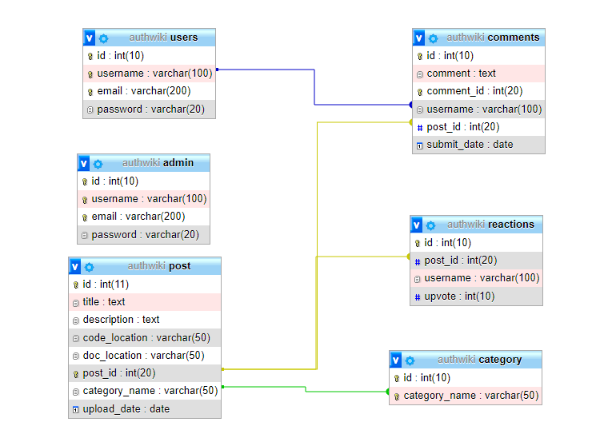
A snippet of the schema is given below:
DB SCHEMA 2

